Slide 1
IBM Cloud Private Performance and Sizing

Slide 2
ICP Performance Analysis
Performance is analyzed based upon 3 representative application architectures
General performance analysis
Sizing your Deployment
Choosing a topology & Sizing Nodes
Tuning the Cluster
Tuning the Cluster

Slide 3
ICP Performance Analysis
Analyzing Performance with Sample Applications

Slide 4
The Polyglot
We will consider a Polyglot application referred to as Acme Air.
This application utilizes multiple programming frameworks.
The intent is to use a general case to evaluate performance and scalability of IBM Cloud Private.

Slide 5
Online Banking
A second more complicated application is used to simulate Online Banking
Simulation of retail online banking (UI, security and services)
Traffic is encrypted and users are authenticated
Backend services interaction has been simulated via Stub Application
Account Summary Page is developed using Angular JS

Slide 6
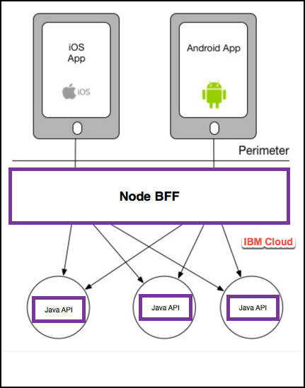
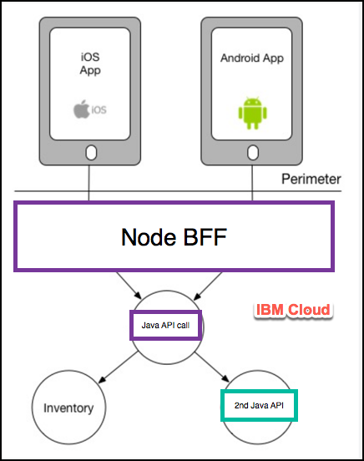
Healthcare Microservices
Typical Microservices application
Architecture comparing 2 and 3 levels

Slide 7
Online Banking Performance on ICP
This type of application scales nearly linearly
Scaling this application, you have massive parallel workload coming in
The runtime (in this case Liberty) must have enough executable threads to manage
Cannot get full use of ICP resources without tuning
Able to saturate by increasing executable threads
The default (orange) line shows only using horizontal scaling does not fully leverage the cluster resources
Understanding the application and its run time shows increasing the Liberty executor thread pool size is crucial for this Java application

Slide 8
Healthcare Application Performance on ICP
Comparison of 2 and 3 level BFF service calls
We desire 3 level BFF microservices
Many platforms suffer massive latency when making the jump from 2 level to 3 level
The results of this testing shows only an approximate 10% difference on ICP
This shows the efficiency of ICP’s networking layer

Slide 9
Healthcare Application Performance on ICP Long-Tail Latency Statistically speaking, the long tail of distributions is the portion of the distribution having a large number of instances or occurrences far from the head (mode or median) of the distribution.
We can consider long-tail latency manifested in the difference between the 90 and 99 percentiles
Long-Tail latency being high typically results in a negative user experience
It can be a difficult problem to solve
Not uncommon in some instances to see 10X (1000%) difference in this region of a distribution
The test shown here shows 0.45X (45%) for IBM Cloud Private

Slide 10
Polyglot Microservices Performance and Scalability on ICP
The test being run in this example is a node.js application accessing a MongoDB data service
We are comparing ”No” and ”Auto” scaling on the node.js service
The services here are deployed within the same cluster
The inability of the application to scale (green line) shows the overall degradation that can occur
These principles still apply as we consider locating the MongoDB externally to the cluster

Slide 11
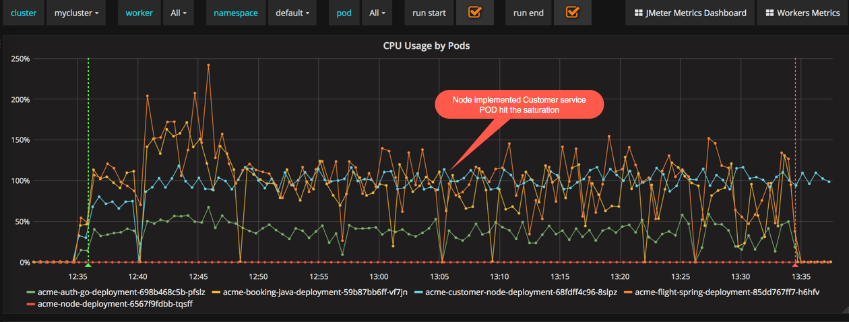
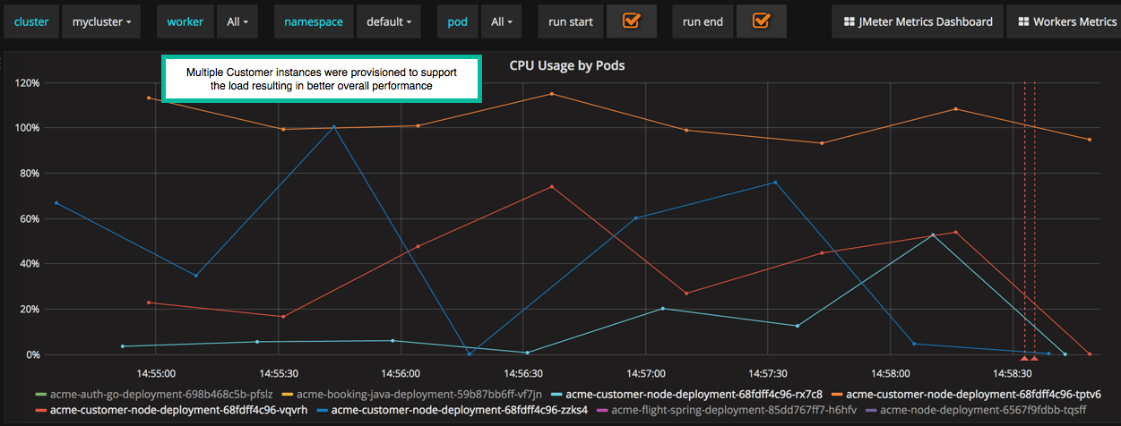
Importance of POD Auto-Scaling on Application Performance
The top chart shows no pod auto-scaling and the bottom chart is with auto-scaling
Top Chart: The blue line shows a pod where the customer service is deployed
Top Chart: The performance is for the most part pegged and demonstrates typical node.js behavior
Top Chart: Unable to push beyond ~100 threads
Bottom Chart: Shows much better performance as the application scales to match demand

Slide 12
Compare On Premise v. Public Data Service
Both workloads are shown using auto-scaling
Shows the impact of network latency introduced with the public data service (Compose MongoDB)
We see linear scaling in the public scenario with lower performance throughout as compared to the on premise configuration

Slide 13
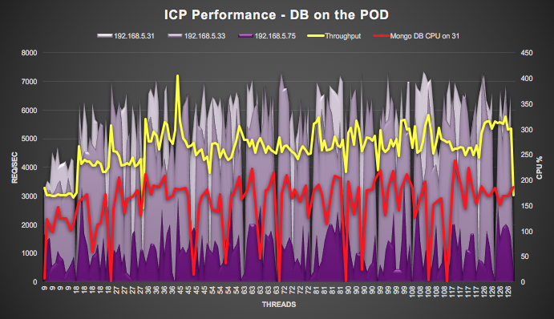
ICP Performance: MongoDB on ICP Cluster
Polyglot microservices with MongoDB deployed via Helm locally into the same cluster
Placement of the DB is crucial for scalability of the overall application
The Yellow line shows the throughput of the polyglot application as load is increased
The Red line shows the associated MongoDB pod CPU activity
The remaining (purple) represents the 3 worker nodes in this cluster (saturates at ~400% CPU)
Maximum performance would occur by separating the workload for MongoDB

Slide 14
Network Intensive Application Performance on ICP
Consider the moving of a legacy application that is network intensive to IBM Cloud Private
For network intensive virtualized workloads migrating to ICP we may require 1/3 more compute to support the same transaction load (as network resources transition to CPU)
Docker networking overhead is the source for this load
Summary: Add an additional 25% capacity for Management / Master nodes and 30% for the running the application

Slide 15
Java EE Application Performance on ICP
For a Java EE 7 workload migrating from on premise virtualized environment to ICP we require an additional 25% capacity to support similar transaction load (this includes the control plane masters, management, etc.)
This is once again due mostly to Docker networking overhead

Slide 16
Cloud Native Application Performance on ICP
For cloud native microservices migrating to ICP from virtualized infrastructure require ~7% additional capacity
This does not include the cluster overhead of ~25% infrastructure increase for the control plane (Masters, Management, …)
This is once again due mostly to Docker networking overhead

Slide 17
Reason for Additional Overhead on ICP
Compare Docker on virtualized infrastructure with virtualized alone
We see overhead from Docker networking
Inefficient handling of software and networking transaction are manifested in higher CPU utilization
This behavior is currently being worked from the platform perspective

Slide 18
Sizing Your Deployment
Choosing a Topology

Slide 19
Considering Capacity
To accurately size you ICP cluster you must consider your workload
Are you running any large containers that require large compute / memory footprints?
What type of applications are you running? Are they microservices … which frameworks / runtimes … ?
Do you applications require persistent or external storage? What type of performance is required for this storage? How many instances of persistent volumes of each type are required?
What are the current resource requirements to run your workloads and how are these requirements expected to change?
19
IBM Cloud / © 2018 IBM Corporation

Slide 20
The Sandbox
Assumptions
Resiliency is a secondary consideration
Maximum pod size is small
Small amount of workload
Vulnerability is not a concern
Role | Count | vCPU / Core | Memory (GB) | Storage (GB)
Master, Boot, Management, etcd | 1 | 4 | 8 | 250
Proxy | 1 | 2 | 4 | 140
Worker | 3 | 4 | 8 | 200
NFS | 1 | 2 | 4 | 300

Slide 21
Production Deployment
Assumptions
This is one possible starting point
Storage must be sized as its own exercise
Etcd should be broken out when ****
The number and specific size of worker nodes depends heavily on the personality of your workload
Role | Count | vCPU / Core | Memory (GB) | Storage (GB)
Boot | 1 | 4 | 8 | 150
Master | 3 or 5 | 8 | 32 | 300
Etcd******* | 1*** | 4*** | 16*** | 150***
Management | 2 or 3 | 8 | 32 | 300
Proxy | 3 | 2 | 4 | 250
Vulnerability Advisor | 1 - 3 | 8 | 32 | 500
Worker | 5+ | 8 | 32 | 250

Slide 22
Boot Node
Boot Node Considerations
Consideration 1
Consideration 2
Externalizing your boot node alleviates some resource constraints during cluster installation
IBM Cloud / © 2018 IBM Corporation

Slide 23
Master Node
Master Node Considerations
At least 3 nodes ensures a quorum can be reached upon failure
Additional nodes help ensure the ability to recovery from failure
Consideration 3
Consideration 4
Only a single Master Node is active at any time
IBM Cloud / © 2018 IBM Corporation

Slide 24
etcd Node
etcd Node Considerations
Consideration
Consideration
Consideration
Impact Statement
IBM Cloud / © 2018 IBM Corporation

Slide 25
Management Node
Management Node Considerations
Consideration
Consideration
Consideration
Impact Statement
IBM Cloud / © 2018 IBM Corporation

Slide 26
Proxy Node
Proxy Node Considerations
Consideration
Consideration
Consideration
Impact Statement
IBM Cloud / © 2018 IBM Corporation

Slide 27
Vulnerability Advisor
Vulnerability Advisor Considerations
Consideration
Consideration
Consideration
Impact Statement
IBM Cloud / © 2018 IBM Corporation

Slide 28
Worker Node
Worker Node Considerations
Consideration
Consideration
Consideration
Impact Statement
IBM Cloud / © 2018 IBM Corporation

Slide 29
Tuning IBM Cloud Private
Best-Practices for Tuning the Cluster

Slide 30
ICP Tuning: The Impact of ICP Access Logging
Performance is impacted by Proxy logging (comparing blue and orange bars in both graphs)
Network intensive loads show this can accumulate up to 30% additional overhead
The overhead is mostly attributable to ELK stack activity

Slide 31
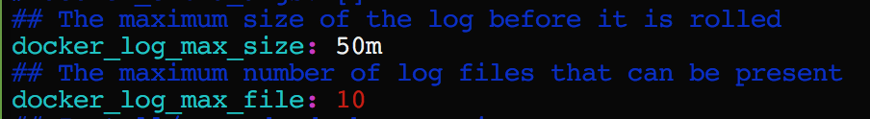
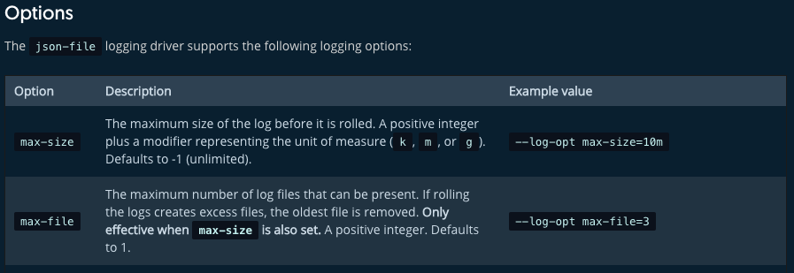
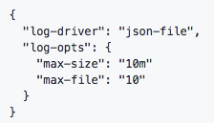
ICP Application Logging
Configure log rotate for Docker (max-size, max-file)
Without log rotate disk may fill and trigger pod eviction (and image garbage collection)
Add install can be configured in config.yaml
If Docker is installed independently
Update Docker services with “—log-opt max-size=10m –log-opt max-file=10”
Add the config to /etc/docker/daemon.json

Slide 32
Impact of Proxy Size and Upstream Keep Alive
Shows the importance of upstream keep-alive
Proxy node capacity is vital, ensure yours is sufficient
For network intensive workloads, bigger proxy node can be more efficient than multiple smaller proxy nodes
Default keep-alive is 32 – consider tuning this based upon your workload
Note: Keep-alive has been enabled by default since ICP 2.1.0.2

Slide 33
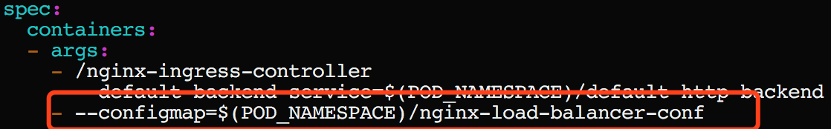
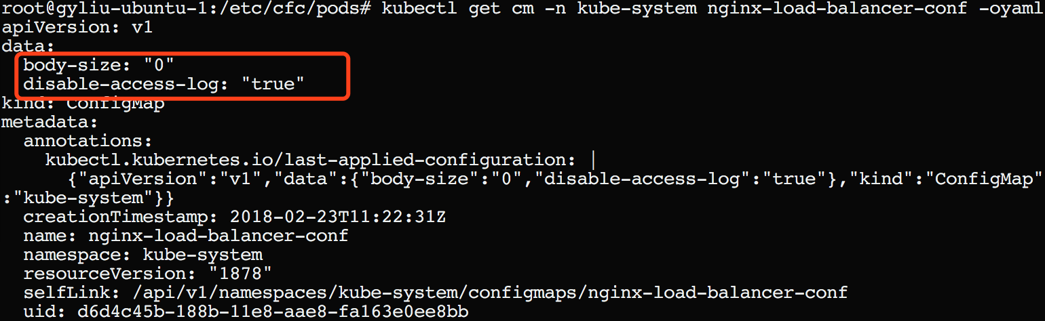
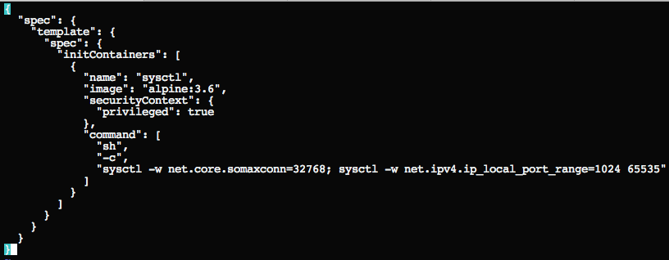
Ingress Parameters
Ingress parameters matter
Check the configmap
Update this configmap for tuning performance
Among the settings to consider for your workload:
Max-worker-connections
Worker-processes
Reference the K8s documentation for detail description: https://github.com/kubernetes/ingress-nginx/blob/master/docs/user-guide/configmap.md
Use initContainer to adjust systctl default values: kubectl patch ds -n kube-system nginx-ingress-lb-amd64 --patch="$(cat patch.json)"

Slide 34
Example: Impact of Liberty Autonomic Threading Algorithm
Java applications running on Liberty with default autonomic threading algorithm may see significant performance degradation
Note: Liberty autonomic algorithm was redesigned in 18.0.0.1 showing a 6X improvement

Slide 35
IBM Cloud Private Large Topology
Performance in Large Topologies

Slide 36
Large Topology Scalability on ICP Clusters Online Banking Application
This example is demonstrated on both 100 and 1000 node cluster
Running 50 instances of the application
The microservices workload scales linearly achieving 4.3 billion API calls per day

Slide 37
Large Topology Supported Product Limits
ICP Version | Maximum Nodes per Cluster | Total Pods Per Cluster | Pod Spec | Worker Node Spec
2.1.0.1 (Kube 1.8.3) | 300 | 9000 | 0.1 CPU, 100M Memory | 4 Core, 8G Memory
2.1.0.2 (Kube 1.9.1) | 500 | 10000 | 0.5 CPU, 512M Memory | 8 Core, 16G Memory
2.1.0.3 | Target 1000 | Target 20000 | 0.5 CPU, 512M Memory | 8 Core, 16G Memory
The node sizes are representation not a recommendation with larger clusters typically accommodating larger configurations
The 2.1.0.3 values are unproven or unverified as of the time of creating this presentation

Slide 38
IBM v. K8s and Supported Product Limits
Kubernetes claims 5000 nodes why can ICP not?
ICP provides extra enterprise capabilities
ICP uses Calico as default network overlay
ICP Calico uses node-to-node mesh to configure peering between all Calico nodes
Calico load increases etcd load and increases greatly for very large clusters (1000+ nodes) **etcd may be broken out in its own node starting in 2.1.0.3
Node-to-node mesh stops working if there are more than 700 nodes in a cluster
Note: It is recommended to configre route relectors for BGP daemons in all cases starting scales approaching 1000 nodes

Slide 39
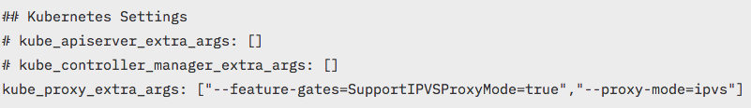
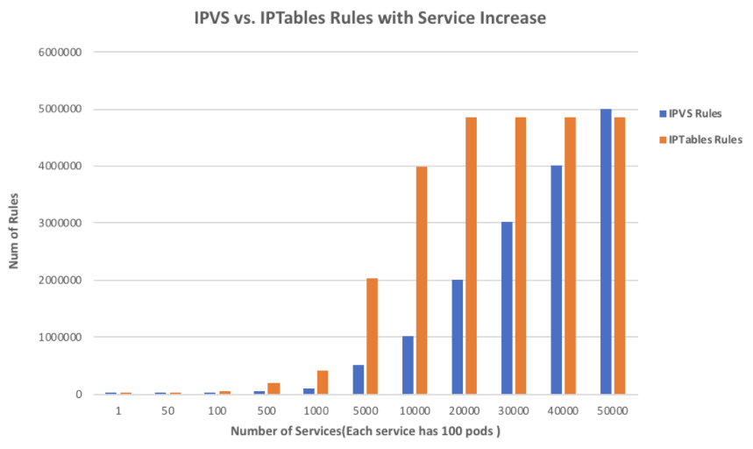
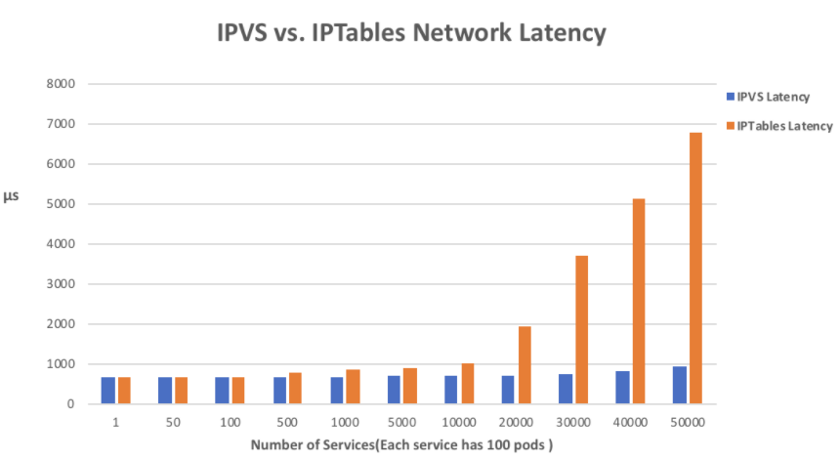
Kube-proxy: IPVS (Beta K8s 1.10, ICP 3.1.0.2)
We have three choices for kube-proxy mode: namespace,
iptables (default), ipvs (beta for 2.1.0.3)
Issues with iptables as a load balancers:
Not incremental: copy all rules, make changes, save back
Locked during update
Time to add one rule when there are 5k services (40k rules): 11 minutes increases to 5 hours for 20k services

Slide 40
In Summary
Consider your workload volumes
Statement
Consider your workload personality
Statement
Consider your performance requirements
Statement
IBM Cloud / © 2018 IBM Corporation
40

Slide 41
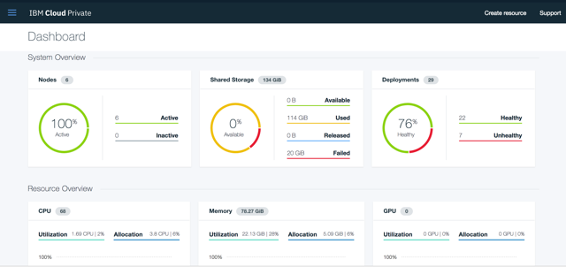
Try IBM Cloud Private today!
Guided and Proof of Technology demos
Free Community Edition!
http://ibm.biz/ICP-DTE
41
41
IBM Cloud / © 2018 IBM Corporation

Slide 42
42

